Slide 1
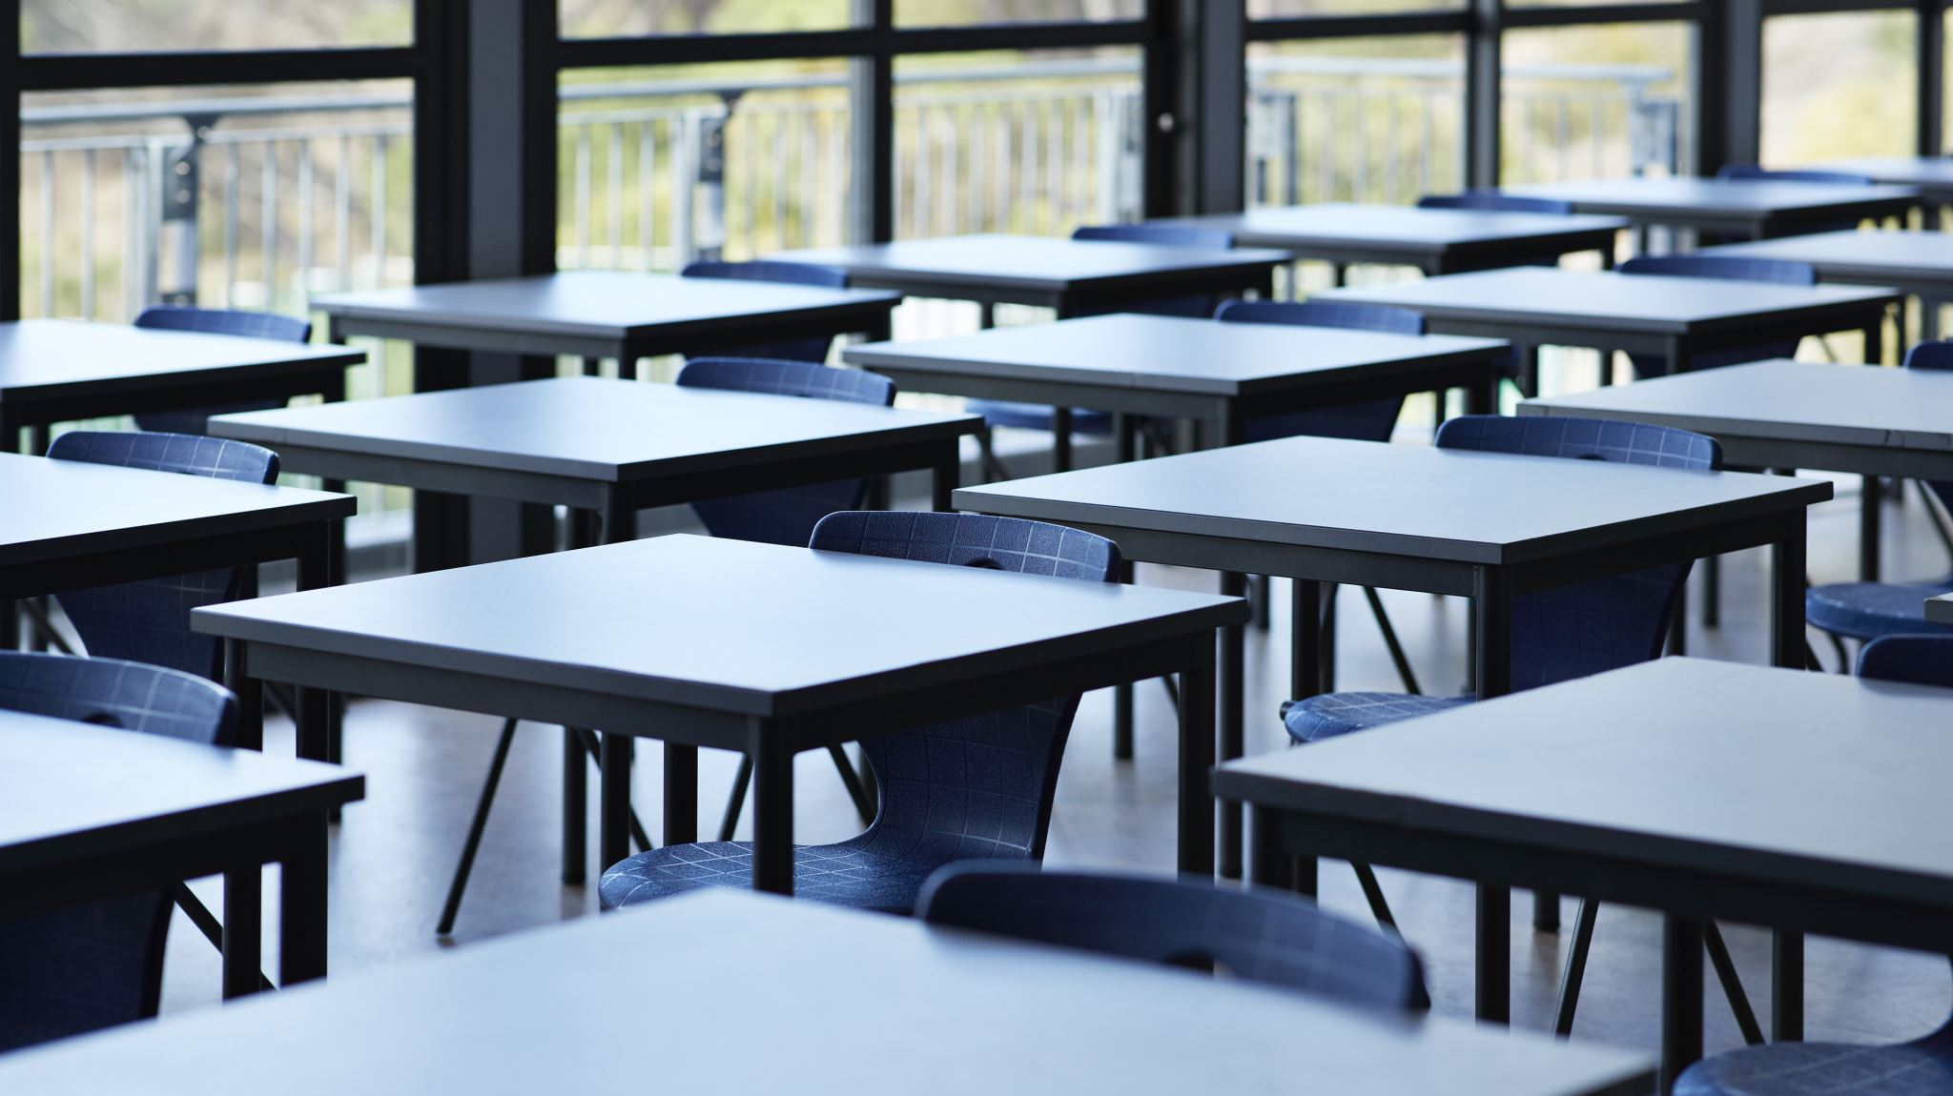
Year 4 Parent meeting

Slide 2
Who we are?
St. Mary Magdalene: Mrs Douglas (Mon-Wed) Mrs Charlick (Thurs-Fri)
St Lucy: Miss Baldwin
Year 4 LSAs: Mrs Hale and Mrs Rae

Slide 3
Changes:
Break time: 10.50 KS2
Lunch time: 12.20
Pick up 3.15

Slide 4
Pe
Tuesday and Thursday for both classes
St. Lucy: swimming end of November and St Mary after Christmas

Slide 5

Reading signing reading record
R

Slide 6
My Maths
Letters with log ins will be given.
Friday to Thursday

Slide 7
Topics
Anglo-Saxons
Vikings
Greeks
Earhquakes/volcanos
Maps
Local area

Slide 8
Trips
Sign consent for local trips: park/beach
Sleepover: summer term

Slide 9

Any Questions

